Slide 1
FAIR USE AND DISCLAIMER
THIS PRESENTATION MAY CONTAIN COPYRIGHTED MATERIALS THE USE OF WHICH HAS NOT BEEN SPECIFICALLY AUTHORIZED BY THE COPYRIGHT OWNER. THIS OPERATES UNDER ASSUMPTION THAT THIS IS NOT FOR COMMERCIAL PURPOSE AND ONLY FAIR USE OF COPYWRIGHT MATERIALS AS PROVIDED FOR IN TITLE 17, CHAPTER 1 SECTION 107 OF THE US COPYRIGHT LAW.
THIS IS MADE FOR ALL AGE AUDIENCE

Slide 2


INTRODUCTION TO EQUATION OF CONTINUITY
CL311 TECHNICAL WRITING
BY
CHEMICAL ENGG. IIT GUWAHATI
180107058
ACKNOWLEDGING : Prof. Raghvendra Gupta

Slide 3
INTRODUCTION TO EQUATION OF CONTINUITY
FLUIDS IN MOTION
CL311 TECHNICAL WRITING
BY
SHUBHAM KUMAR GUPTA
CHEMICAL ENGG. IIT GUWAHATI
180107058
ACKNOWLEDGING : Prof. Raghvendra Gupta

Slide 4
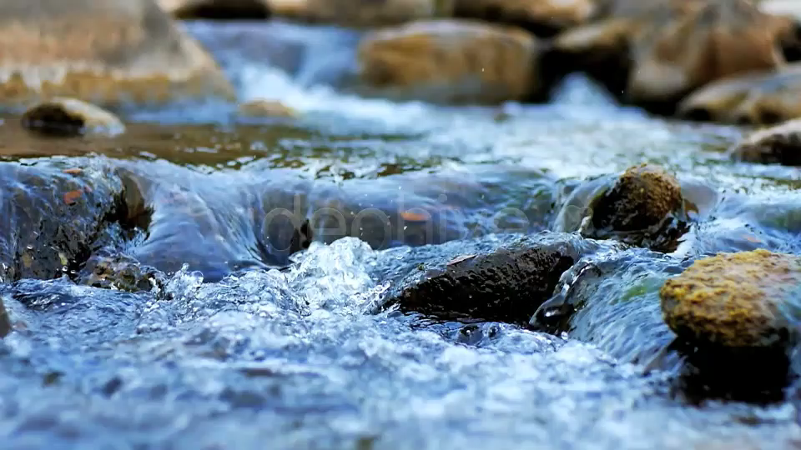
FLUIDS IN MOTION
source deephive

Slide 5



FLUIDS IN MOTION

Slide 6

FLUIDS IN MOTION

Slide 7
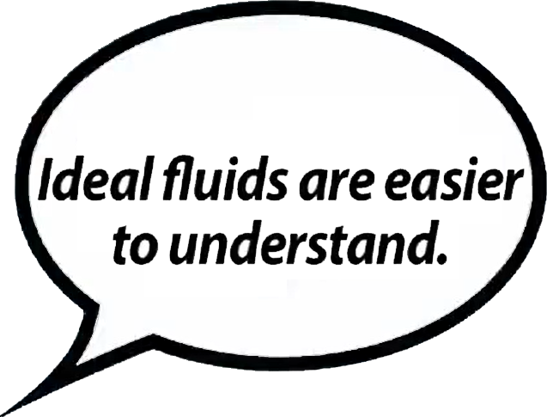
FLUIDS IN MOTION

Slide 8
FLUIDS IN MOTION
1. Incompressible
Its density can’t be changed
source evancom

Slide 9
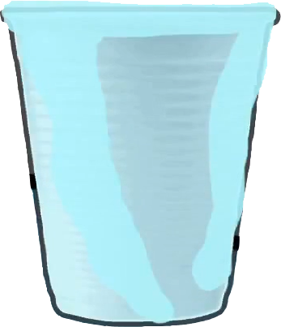
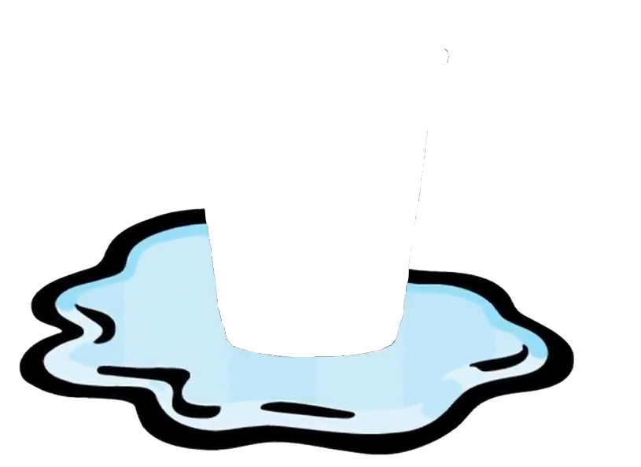
FLUIDS IN MOTION
2. Laminar
A steady, constant flow
Fill 8 kg water into 4 kg container
source pinterest

Slide 10
1. Incompressible
FLUIDS IN MOTION
Its density can’t be changed
2. Laminar
A steady, constant flow
source evancom

Slide 11
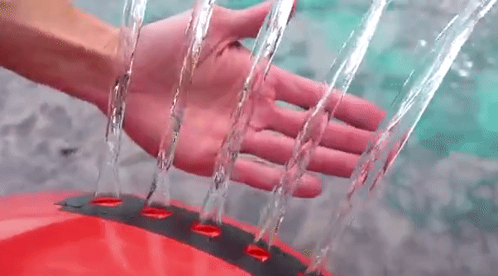
FLUIDS IN MOTION
3. Non-Viscous
There is no resistance to flow
LAMINAR FLOW OF WATER
source youtube

Slide 12
1. Incompressible
FLUIDS IN MOTION
Its density can’t be changed
2. Laminar
A steady, constant flow
3. Non-Viscous
There is no resistance to flow
source evancom

Slide 13


FLUIDS IN MOTION
VISCOCITY
The resistance to flow
HONEY
source pinterest
WATER
source pinterest

Slide 14
VISCOCITY
WATER
source pinterest
The resistance to flow
THE EQUATION OF CONTINUITY
FLUIDS IN MOTION
HONEY
source pinterest

Slide 15
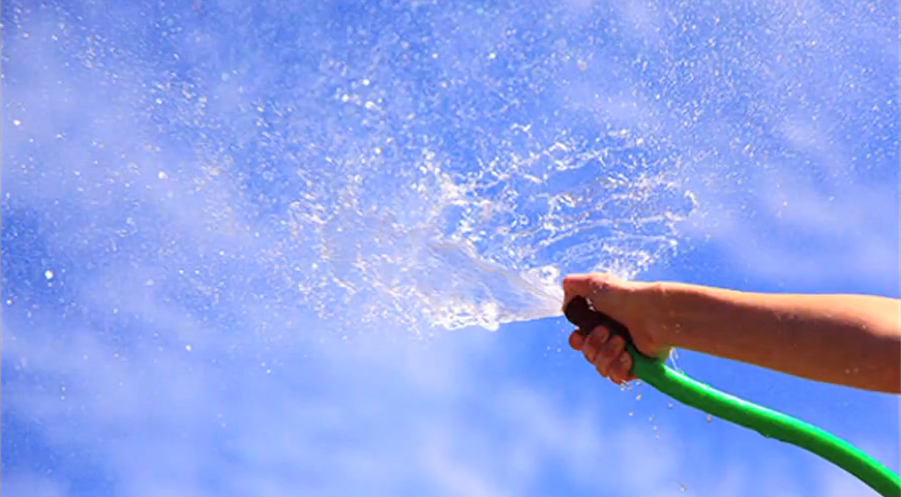

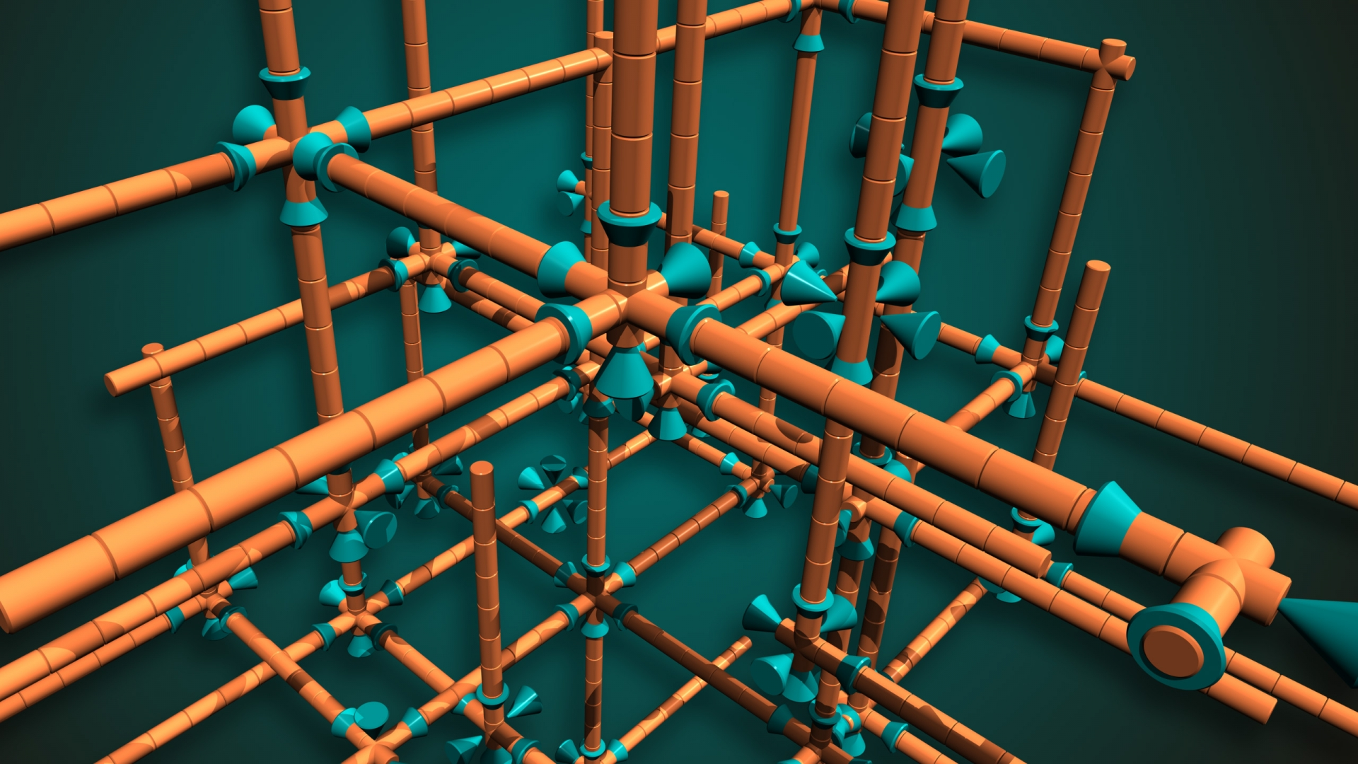
THE EQUATION OF CONTINUITY
Nozzle when half closed
source pinterest

Slide 16

THE EQUATION OF CONTINUITY
Continuity equation says that flow rate has the same value
at every position along a tube that has a single entry and a single exit for fluid flow.
Valid for any types of pipe
source cyberprint

Slide 17


THE EQUATION OF CONTINUITY
Continuity equation says that flow rate has the same value
at every position along a tube that has a single entry and a single exit for fluid flow.
Fluid flowing inside pipe
source cyberprint

Slide 18
THE EQUATION OF CONTINUITY
Continuity equation says that flow rate has the same value
at every position along a tube that has a single entry and a single exit for fluid flow.
Fluid flowing inside pipe
source cyberprint

Slide 19
THE EQUATION OF CONTINUITY
Continuity equation says that flow rate has the same value
at every position along a tube that has a single entry and a single exit for fluid flow.
Fluid flowing inside pipe
source cyberprint

Slide 20
THE EQUATION OF CONTINUITY
Continuity equation says that flow rate has the same value
at every position along a tube that has a single entry and a single exit for fluid flow.
Fluid flowing inside pipe
source cyberprint

Slide 21
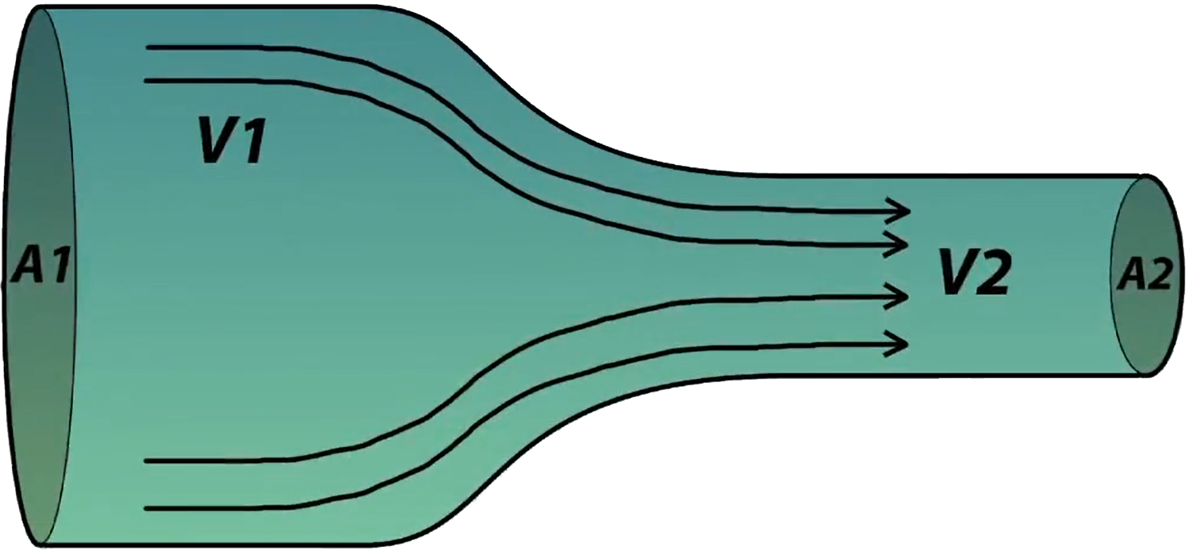
THE EQUATION OF CONTINUITY
Garden hose when nozzle
source pinterest

Slide 22
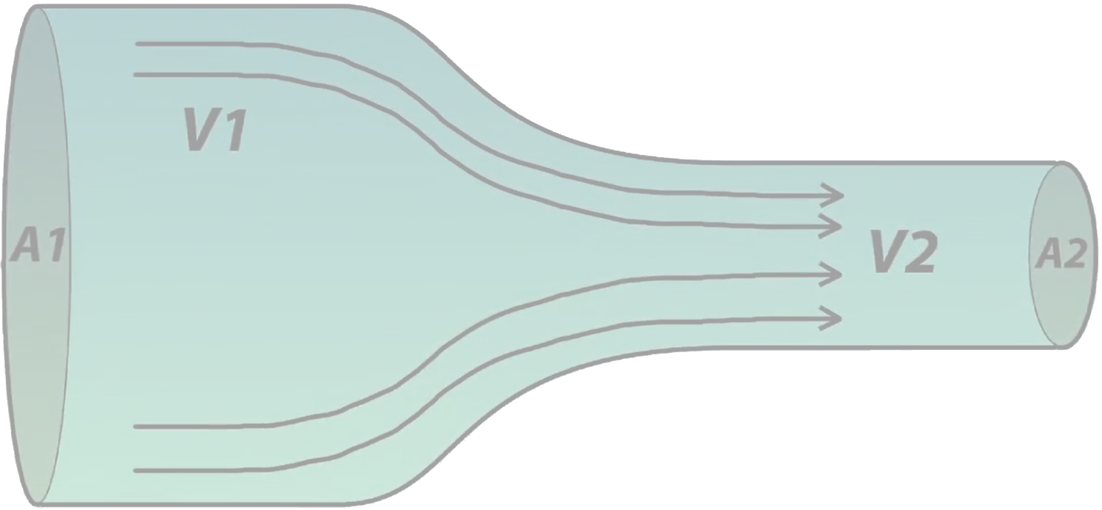
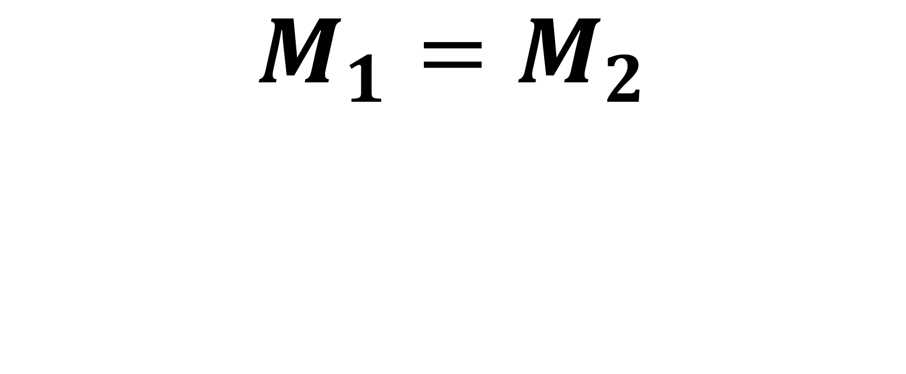

THE EQUATION OF CONTINUITY
The Equation of Continuity
$$M_{1}=M_{2}$$
$$M=mass$$
Formulation
source pinterest

Slide 23
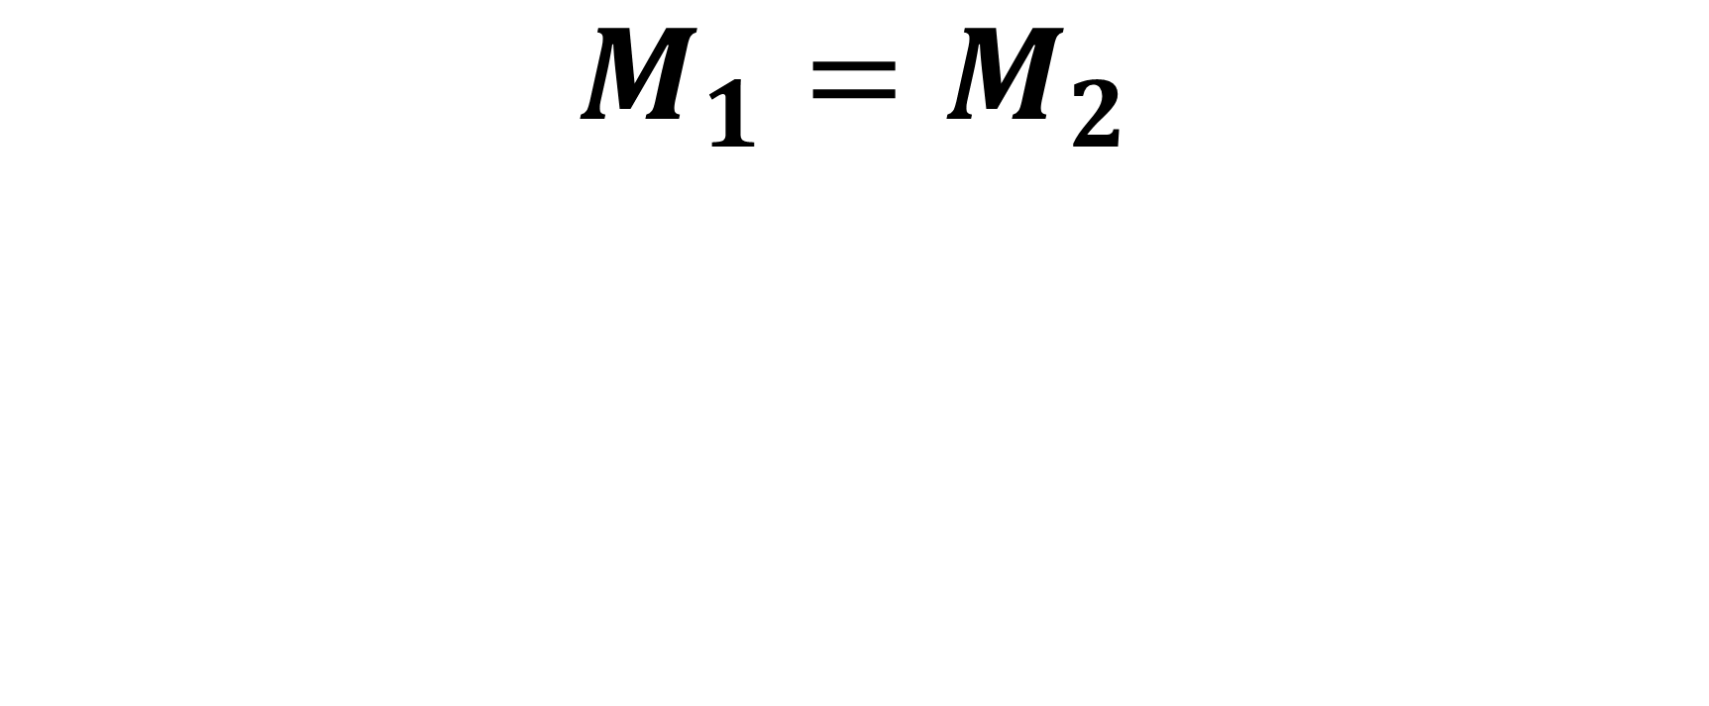
THE EQUATION OF CONTINUITY
The Equation of Continuity
$$M_{1}=M_{2}$$
$$M=mass$$
Formulation
source pinterest

Slide 24
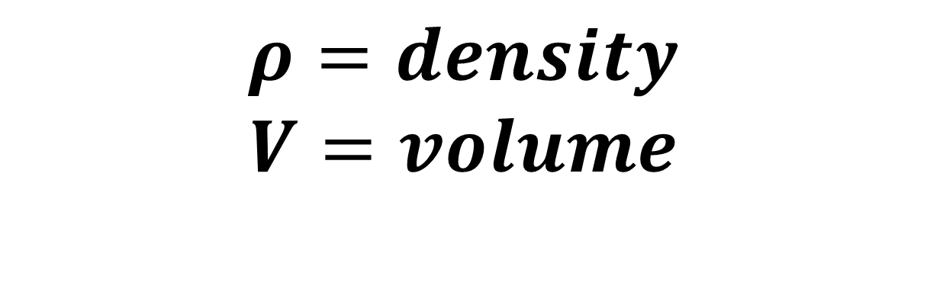
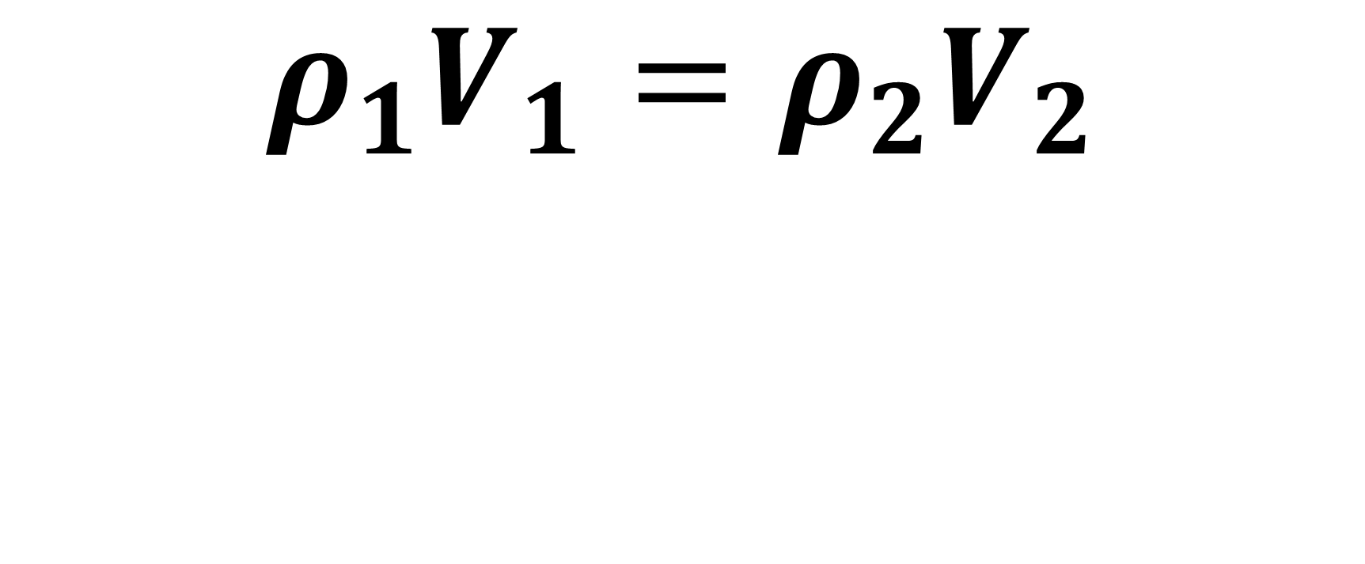
THE EQUATION OF CONTINUITY
The Equation of Continuity
$$ρ_{1}V_{1}=ρ_{2}V_{2}$$
$$ρ=density$$
$$V=volume$$
Formulation
source pinterest

Slide 25
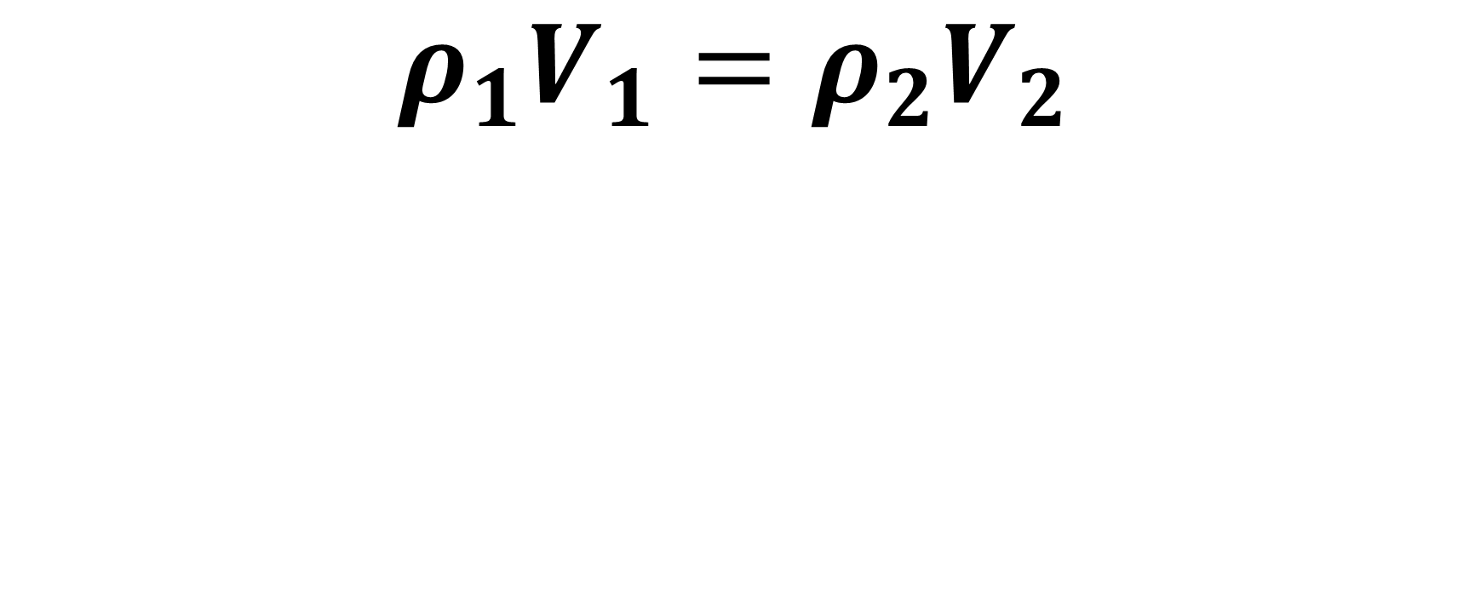
THE EQUATION OF CONTINUITY
The Equation of Continuity
$$ρ_{1}V_{1}=ρ_{2}V_{2}$$
$$ρ=density$$
$$V=volume$$
Formulation
source pinterest

Slide 26
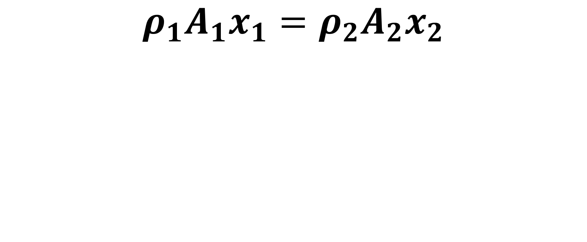
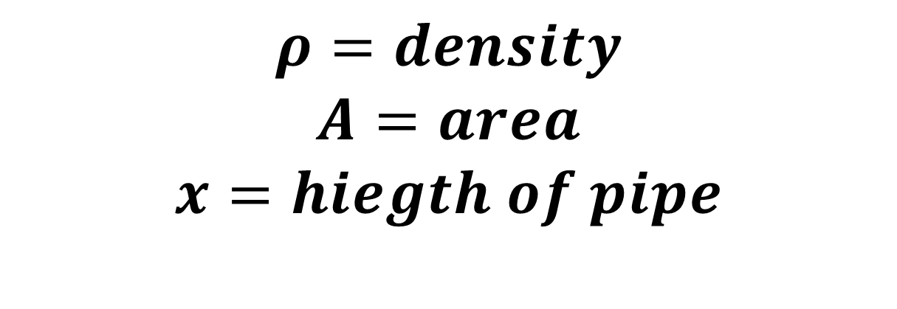
THE EQUATION OF CONTINUITY
The Equation of Continuity
$$ρ_{1}{A_{1}x}_{1}=ρ_{2}{A_{2}x}_{2}$$
$$ρ=density$$
$$A=area$$
$$x=hiegth of pipe$$
Formulation
source pinterest

Slide 27
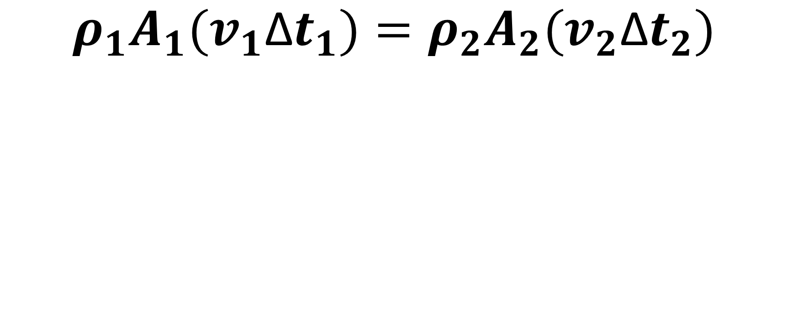
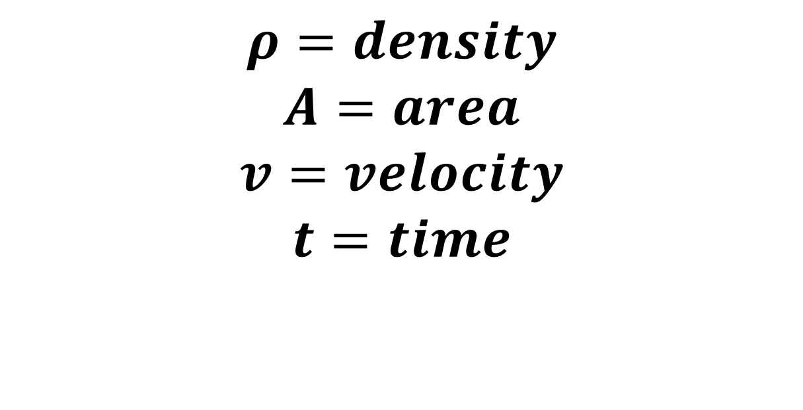
THE EQUATION OF CONTINUITY
The Equation of Continuity
$$ρ_{1}{A_{1}(v}_{1}\text{Δ}t_{1})=ρ_{2}{A_{2}(v}_{2}\text{Δ}t_{2})$$
$$ρ=density$$
$$A=area$$
$$v=velocity$$
$$t=time$$
Formulation
source pinterest

Slide 28
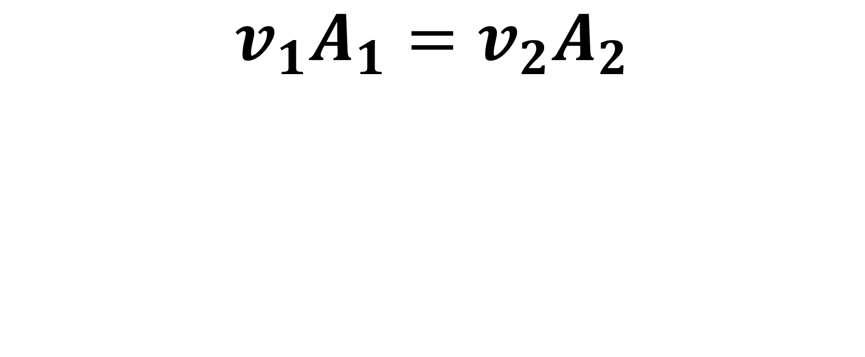

THE EQUATION OF CONTINUITY
The Equation of Continuity
$$v_{1}A_{1}=v_{2}A_{2}$$
$$V=velocity$$
$$A=area$$
Formulation
source pinterest

Slide 29

THE EQUATION OF CONTINUITY
The Equation of Continuity
$$v_{1}A_{1}=v_{2}A_{2}$$
$$v=velocity$$
$$A=area$$
Formulation
source pinterest

Slide 30

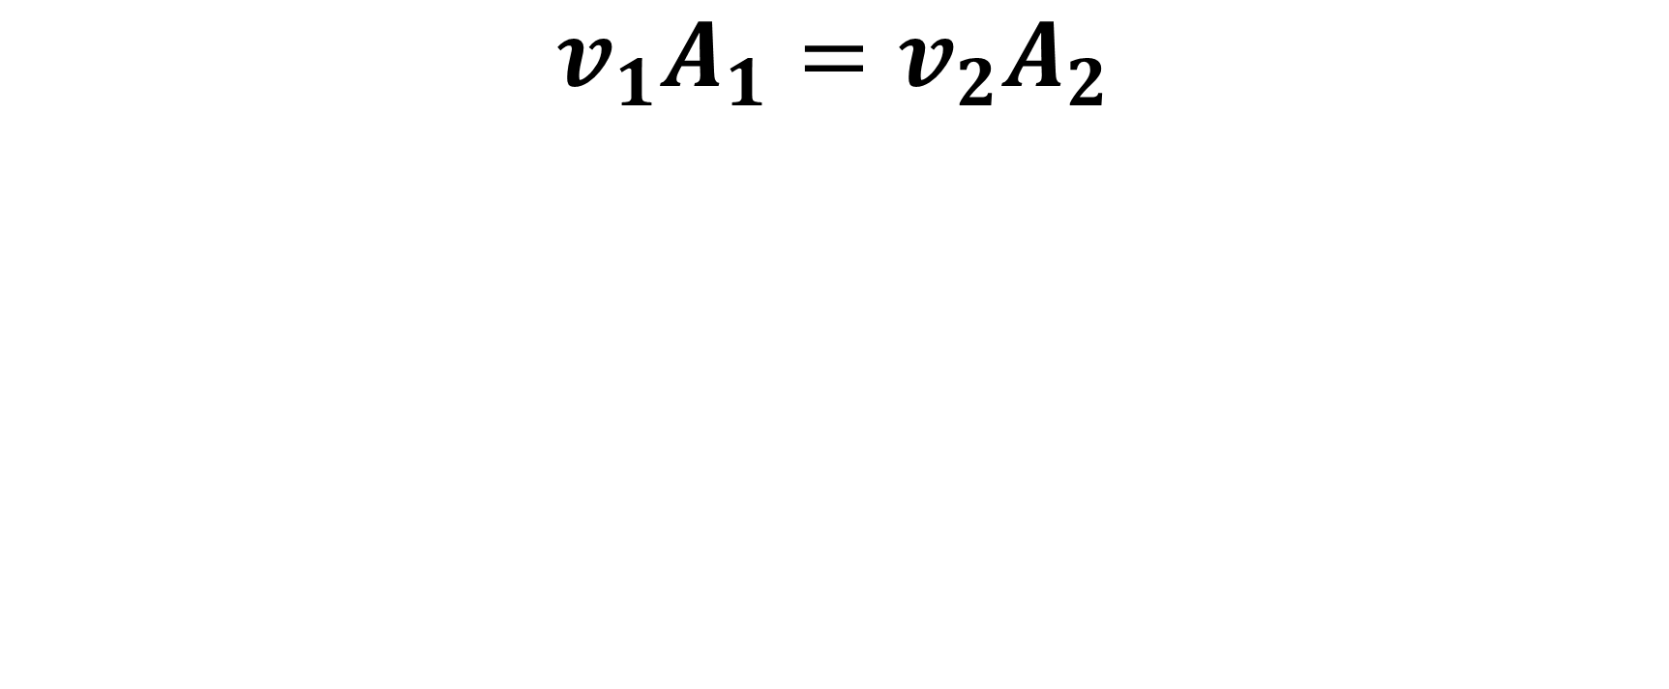
THE EQUATION OF CONTINUITY
The Equation of Continuity
$$v_{1}A_{1}=v_{2}A_{2}$$
Formulation
source pinterest

Slide 31
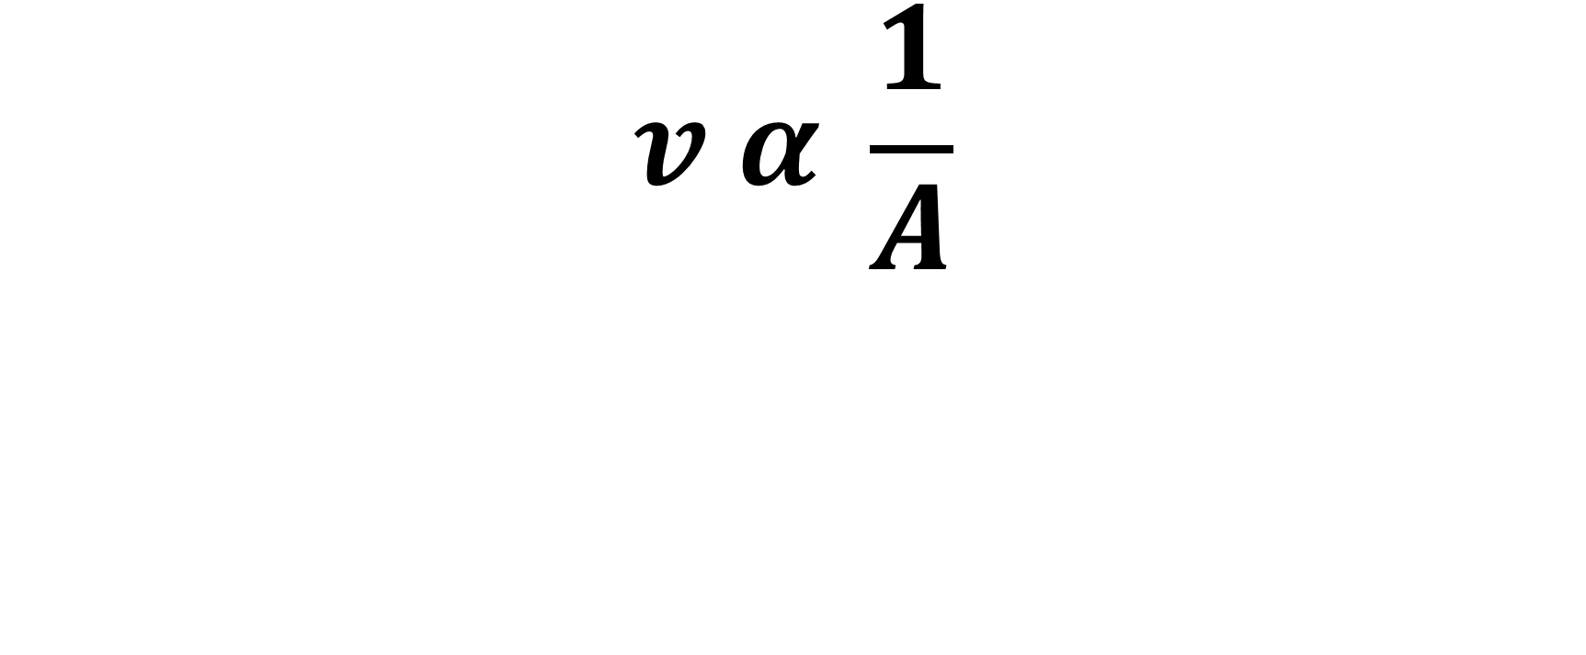

THE EQUATION OF CONTINUITY
$$A$$
The Equation of Continuity
$$v α \frac{1}{A}$$
Formulation
source pinterest

Slide 32
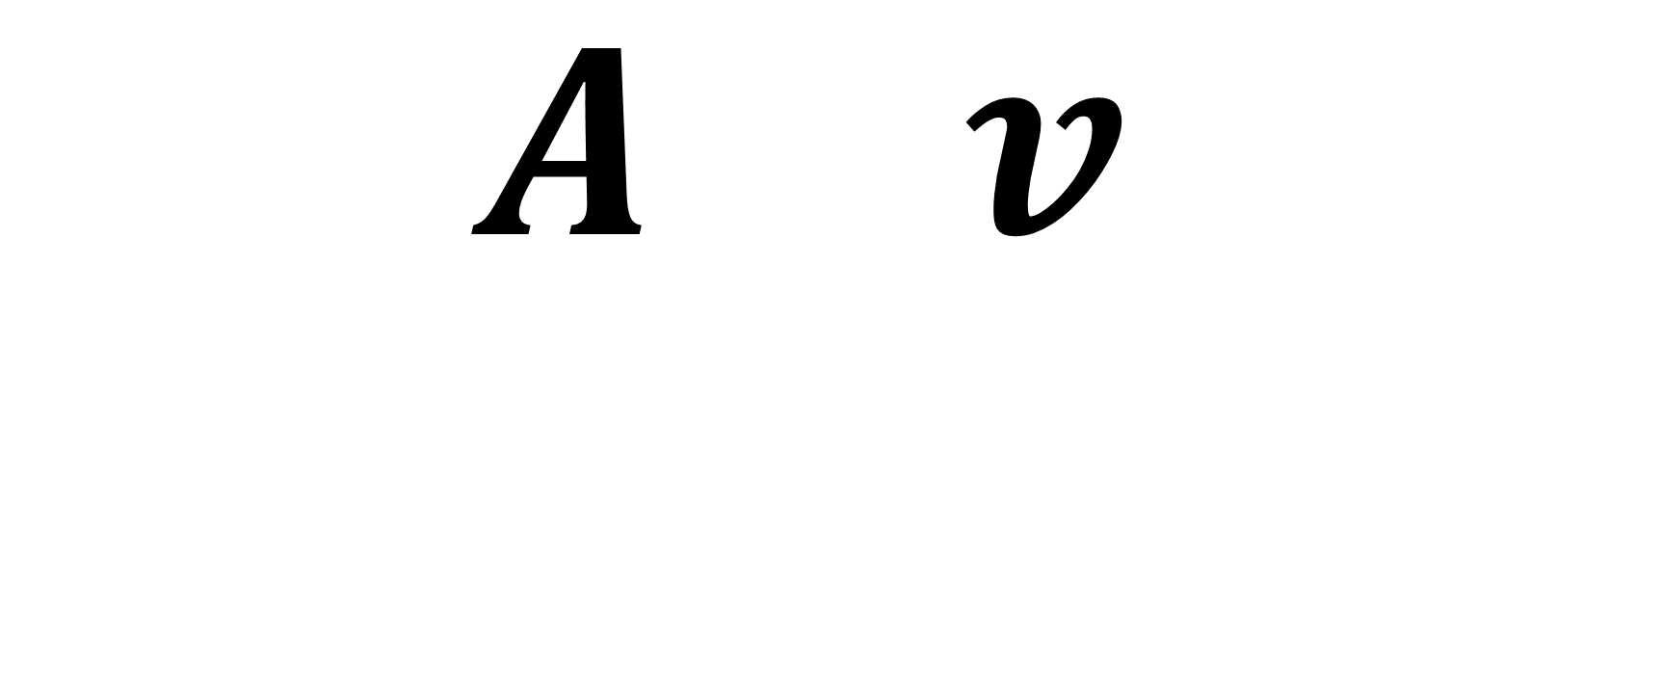
THE EQUATION OF CONTINUITY
$$A v$$
$$Higher area, lower velocity$$
MOTOR HOSE SIMULATION
source cliparts

Slide 33
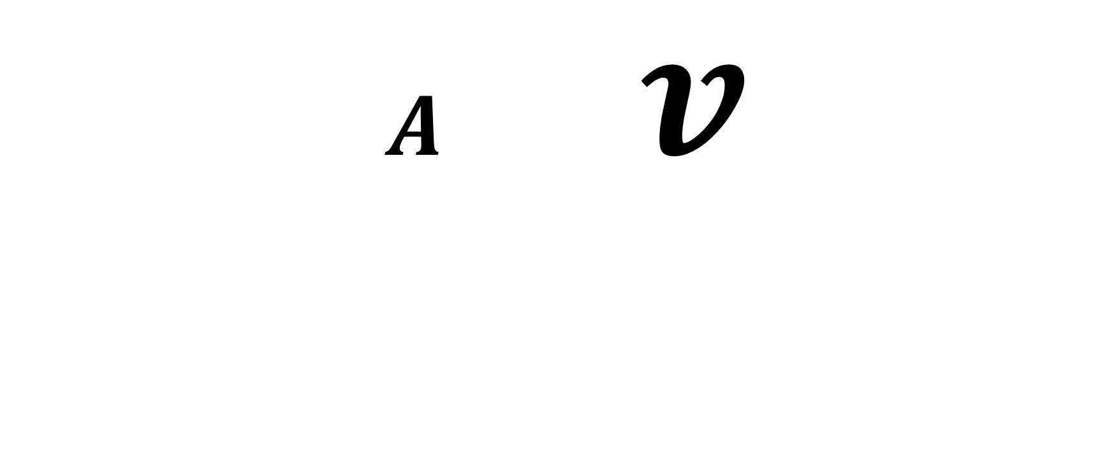
THE EQUATION OF CONTINUITY
$A$ $v$
$$Lower area, higher velocity$$
MOTOR HOSE SIMULATION
source cliparts

Slide 34
THE EQUATION OF CONTINUITY
Conclusion
Continuity Equation says for ideal fluid, speeds up going to smaller opening, slows down going to larger opening
Velocity of fluid which is incompressible Inverse with area of the pipe where the fluids are flowing

Slide 35
THE EQUATION OF CONTINUITY
Sources & Citations
Fluid mechanics for chemical engineers Book by James O. Wilkes
Fluid mechanics for chemical engineers Book by Mathieu Mory
https://en.wikipedia.org/wiki/Fluid_dynamics
http://ctmd.oum.edu.my/v2/tut orkits/
Fluid dynamics of sprinkler systems: https://www.cabdirect.org/cabdirect/abstract/19811964663
Author(s) : Heermann, D. F. ; Kohl, R. A.
Editors : Jensen, M. E.

Slide 36
Thank You!!

